Slide 1
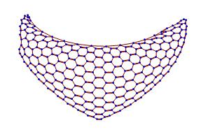
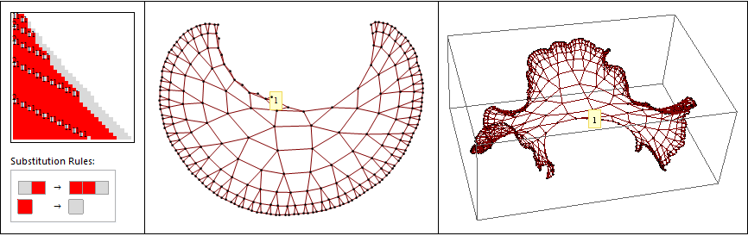
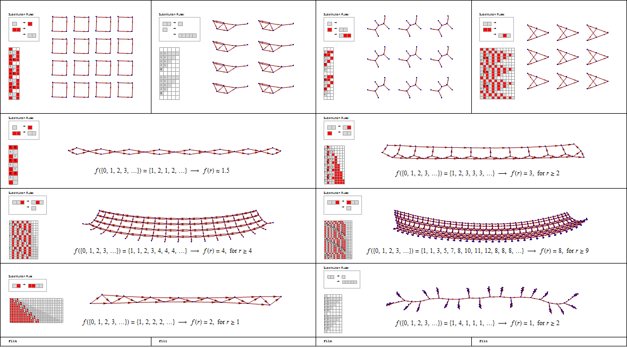
SESSIE NetWorks
Causal networks of SSSs
(Sequential Substitution Systems)
Pattern Hunting!

Slide 2












Breanna Bowden-Green W11
Kelsey Dobbs, W10
Amy Bead W12
Christen Case
F14
Jade Deschamps
Camille Morrow
W18
1. Human inspection of networks.
2. Mathematical treatment of network properties.
3. Improved enumeration & acceleration.
Lucas Valenca
F16
Drew Blake
W17
Sarah Wu
Josh Wade
Jeanna Toulouse
W19
Christofer Trana
W19
4. Logic & Programming
5. Identifying Networks
Researchers in the SESSIE project at Southern Adventist University

Slide 3
Simple Rules → Complex Behavior
Strategy:
Take all possible sets of simple rules
Apply them repeatedly
Look for complex behavior
Features similar to the real universe?
But HOW?

Slide 4
Enter…
The Complete Enumeration
of ALL Rulesets
But wait, aren’t there an infinite number of these rulesets?
Multiple infinities!
Any number of rules, any length strings, any characters

Slide 5
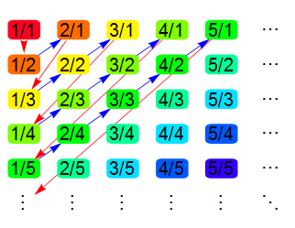
List of all possible FRACTIONS
Inspired by Cantor’s enumeration of all fractions

Slide 6
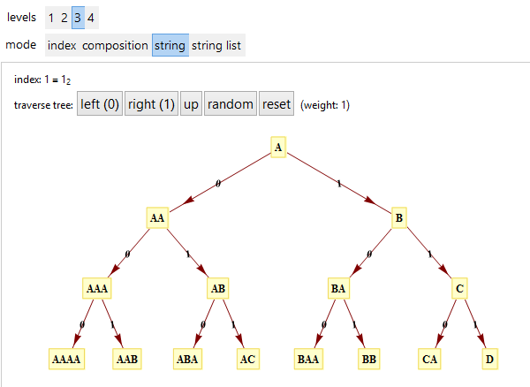
List of all possible STRINGS
Inspired by Cantor’s enumeration of all fractions
Universal String Enumeration aka Tree of All Strings
http://demonstrations.wolfram.com/UniversalStringEnumeration/
http://demonstrations.wolfram.com/TreeOfStrings/

Slide 7
List of all possible rule sets
Inspired by Cantor’s enumeration of all fractions
Universal String Enumeration aka Tree of All Strings
http://demonstrations.wolfram.com/TreeOfStrings/
Enumeration of all SSS rule sets
http://www.mathematica-journal.com/ 2011/05/indexing-strings-and-rulesets/
Improved Generalized SS Enumeration
To be published: KC & Christen Case (SAU 2015)

Slide 8
Improved SS Enumeration
allows massive acceleration
millions of times faster!
Christen Case
F14
Camille Morrow
W18
Jade Deschamps
Base-5 digit meanings:
0. End this string, insert two empty strings, start a new string with an “A”.
1. End this string, insert one empty string, start a new string with an “A”.
2. End this string and start a new string with an “A”.
3. End this character and start a new character (as an “A”).
4. Increment this character.

Slide 9
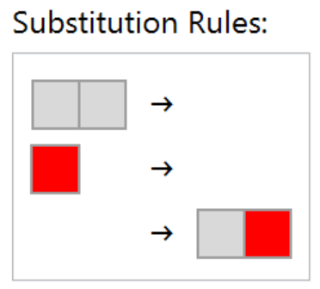
A simple example
Let’s build this ruleset from its base-5 code identifier:
The subscript “5” (base) reminds us that are only 5 allowed digits:
0, 1, 2, 3, 4
Each digit has a precise significance for constructing the ruleset, and this base-5 code identifies and results in one unique ruleset.
314034₅
Notes:
All sessies are generated from sets of substitution rules, and every ruleset corresponds to a unique code number. Let’s build this ruleset …

Slide 10
Base-5 digit meanings:
0. End this string, insert two empty strings and start a new string with an “A”.
1. End this string, insert one empty string and start a new string with an “A”.
2. End this string and start a new string with an “A”.
3. End this character and start a new character (as an “A”).
4. Increment this character.
A simple example: 314034
Ruleset under construction:
Start: {“A”}
Notes:
A simple one, but containing the digits 0 and 1. Again, start with a single A.

Slide 11
Base-5 digit meanings:
0. End this string, insert two empty strings and start a new string with an “A”.
1. End this string, insert one empty string and start a new string with an “A”.
2. End this string and start a new string with an “A”.
3. End this character and start a new character (as an “A”).
4. Increment this character.
A simple example: 314034
Ruleset under construction:
{“A”}
=> {“AA”}
Notes:
Append

Slide 12
Base-5 digit meanings:
0. End this string, insert two empty strings and start a new string with an “A”.
1. End this string, insert one empty string and start a new string with an “A”.
2. End this string and start a new string with an “A”.
3. End this character and start a new character (as an “A”).
4. Increment this character.
A simple example: 314034
Ruleset under construction:
{“AA”}
=> {“AA”->“”, “A”}
Notes:
1 means “insert an empty string, then start a new string with a single A”

Slide 13
Base-5 digit meanings:
0. End this string, insert two empty strings and start a new string with an “A”.
1. End this string, insert one empty string and start a new string with an “A”.
2. End this string and start a new string with an “A”.
3. End this character and start a new character (as an “A”).
4. Increment this character.
A simple example: 314034
Ruleset under construction:
{“AA”->“”, “A”}
=> {“AA”->“”, “B”}
Notes:
Increment

Slide 14
Base-5 digit meanings:
0. End this string, insert two empty strings and start a new string with an “A”.
1. End this string, insert one empty string and start a new string with an “A”.
2. End this string and start a new string with an “A”.
3. End this character and start a new character (as an “A”).
4. Increment this character.
A simple example: 314034
Ruleset under construction:
{“AA”->“”, “B”}
=> {“AA”->“”, “B”->“”, “”->“A”}
Notes:
0 means “insert 2 empty strings, then a new string starting with an A”

Slide 15
Base-5 digit meanings:
0. End this string, insert two empty strings and start a new string with an “A”.
1. End this string, insert one empty string and start a new string with an “A”.
2. End this string and start a new string with an “A”.
3. End this character and start a new character (as an “A”).
4. Increment this character.
A simple example: 314034
Ruleset under construction:
{“AA”->“”, “B”->“”, “”->“A”}
=> {“AA”->“”, “B”->“”, “”->“AA”}
Notes:
Append

Slide 16
Base-5 digit meanings:
0. End this string, insert two empty strings and start a new string with an “A”.
1. End this string, insert one empty string and start a new string with an “A”.
2. End this string and start a new string with an “A”.
3. End this character and start a new character (as an “A”).
4. Increment this character.
A simple example: 314034
Ruleset under construction:
{“AA”->“”, “B”->“”, “”->“AA”}
=> {“AA”->“”, “B”->“”, “”->“AB”}
Notes:
Increment

Slide 17
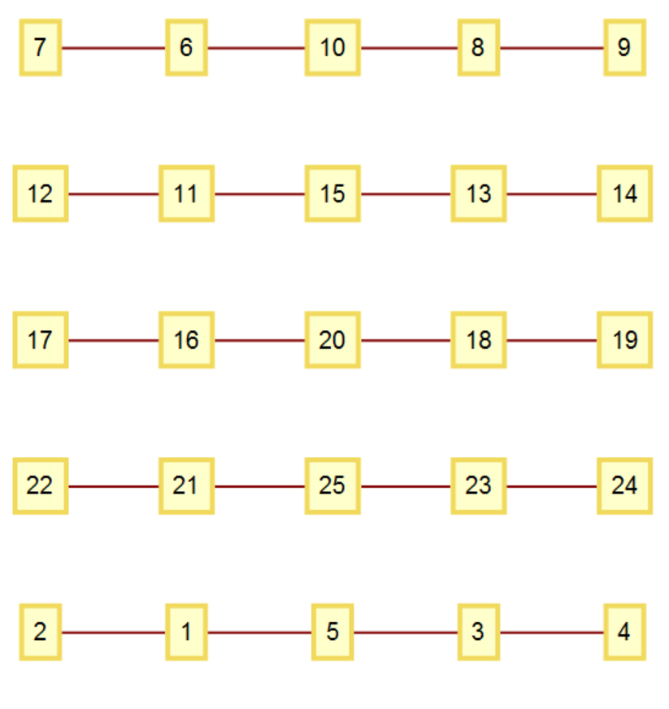
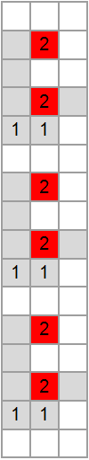
Base-5 digit meanings:
0. End this string, insert two empty strings and start a new string with an “A”.
1. End this string, insert one empty string and start a new string with an “A”.
2. End this string and start a new string with an “A”.
3. End this character and start a new character (as an “A”).
4. Increment this character.
A simple example: 314034
Ruleset under construction:
{“AA”->“”, “B”->“”, “”->“AB”}
DONE!
Notes:
Done. Although this simpler ruleset generates a rather simple repetitive sessie and network, as shown here.

Slide 18
List of all possible rule sets
A more complicated example…

Slide 19
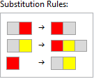
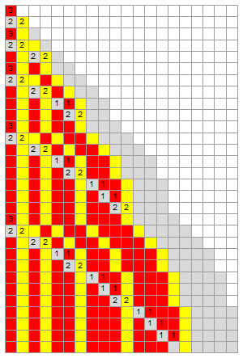
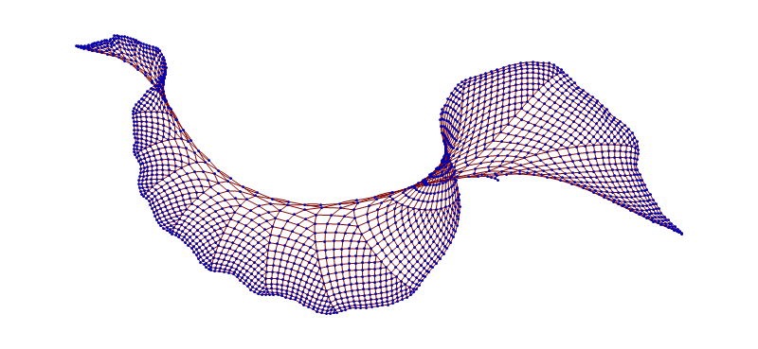
Our first 3-d network: {"AB"->"BA", "AC"->"BCA", "B"->"AC"}
Notes:
Or start filling up a 3rd dimension. This could be arranged to evenly fill a growing cone-shape in 3 dimensions, but it does need 3-d.

Slide 20
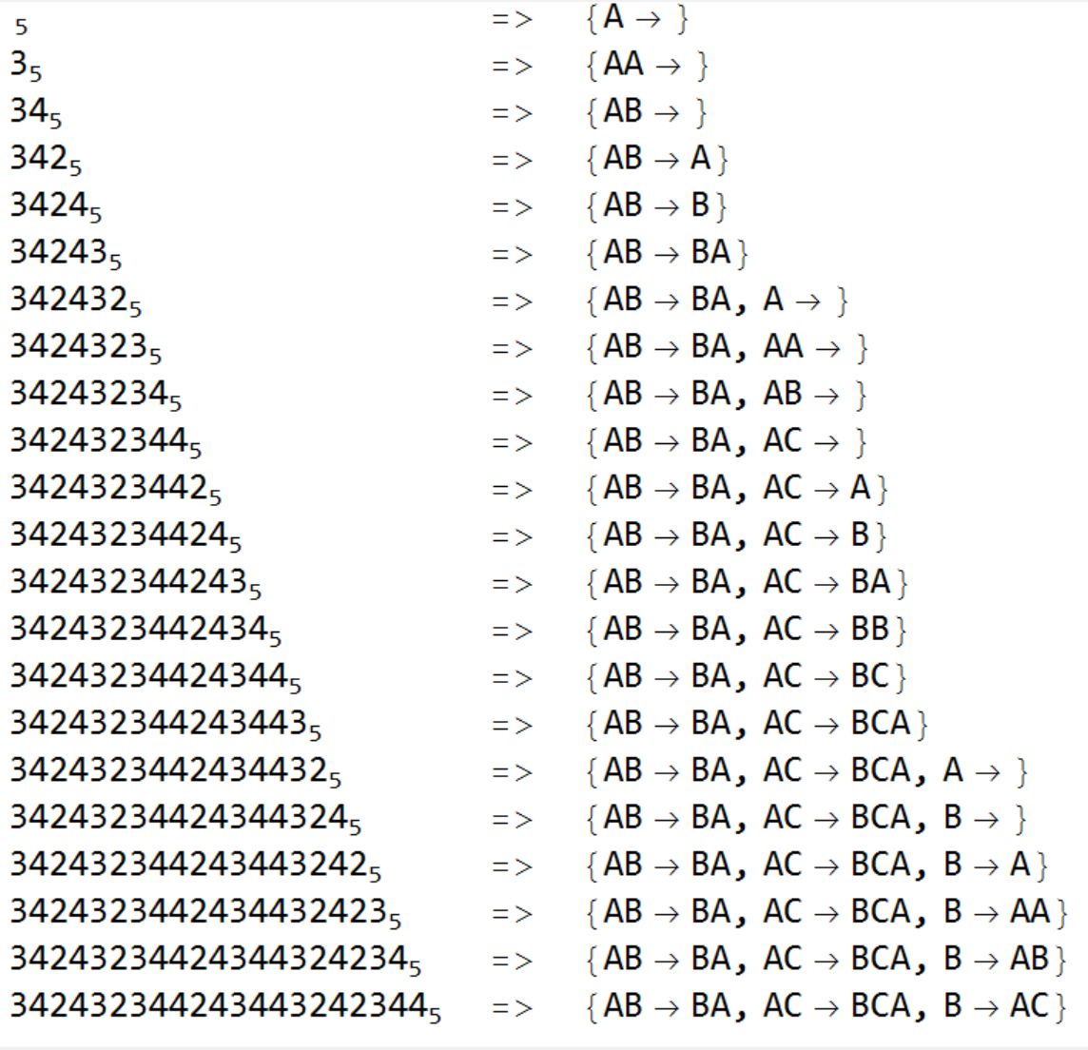
Base-5 digit meanings:
0. End this string, insert two empty strings and start a new string with an “A”.
1. End this string, insert one empty string and start a new string with an “A”.
2. End this string and start a new string with an “A”.
3. End this character and start a new character (as an “A”).
4. Increment this character.
Too Fast!
Base-5 Code: Ruleset under construction:
Notes:
Camille, can you make the window at the bottom scroll up?
After all the code digits are scanned, the complete ruleset has been built. Wait, that was too fast!

Slide 21
Base-5 digit meanings:
0. End this string, insert two empty strings and start a new string with an “A”.
1. End this string, insert one empty string and start a new string with an “A”.
2. End this string and start a new string with an “A”.
3. End this character and start a new character (as an “A”).
4. Increment this character.
Digit being treated: 342432344243443242344
Ruleset under construction:
Start: {“A”}
Notes:
Let’s look at it one step at a time. Even before we look at any of the digits, we start the ruleset with a single “A”.

Slide 22
Base-5 digit meanings:
0. End this string, insert two empty strings and start a new string with an “A”.
1. End this string, insert one empty string and start a new string with an “A”.
2. End this string and start a new string with an “A”.
3. End this character and start a new character (as an “A”).
4. Increment this character.
“Append”
“Increment”
Digit being treated: 342432344243443242344
Ruleset under construction:
{“A”}
=> {“AA”}
Notes:
3 means “append an A”

Slide 23
Base-5 digit meanings:
0. End this string, insert two empty strings and start a new string with an “A”.
1. End this string, insert one empty string and start a new string with an “A”.
2. End this string and start a new string with an “A”.
3. End this character and start a new character (as an “A”).
4. Increment this character.
“Append”
“Increment”
Digit being treated: 342432344243443242344
Ruleset under construction:
{“AA”}
=> {“AB”}
Notes:
4 means “increment the final character”

Slide 24
Base-5 digit meanings:
0. End this string, insert two empty strings and start a new string with an “A”.
1. End this string, insert one empty string and start a new string with an “A”.
2. End this string and start a new string with an “A”.
3. End this character and start a new character (as an “A”).
4. Increment this character.
“Append”
“Increment”
Digit being treated: 342432344243443242344
Ruleset under construction:
{“AB”}
=> {“AB”->“A”}
Notes:
2 means “end this string and start a new string with a single A”

Slide 25
Base-5 digit meanings:
0. End this string, insert two empty strings and start a new string with an “A”.
1. End this string, insert one empty string and start a new string with an “A”.
2. End this string and start a new string with an “A”.
3. End this character and start a new character (as an “A”).
4. Increment this character.
“Append”
“Increment”
Digit being treated: 342432344243443242344
Ruleset under construction:
{“AB”->“A”}
=> {“AB”->“B”}
Notes:
Increment the A to become a B

Slide 26
Base-5 digit meanings:
0. End this string, insert two empty strings and start a new string with an “A”.
1. End this string, insert one empty string and start a new string with an “A”.
2. End this string and start a new string with an “A”.
3. End this character and start a new character (as an “A”).
4. Increment this character.
“Append”
“Increment”
Digit being treated: 342432344243443242344
Ruleset under construction:
{“AB”->“B”}
=> {“AB”->“BA”}
Notes:
Append an A

Slide 27
Base-5 digit meanings:
0. End this string, insert two empty strings and start a new string with an “A”.
1. End this string, insert one empty string and start a new string with an “A”.
2. End this string and start a new string with an “A”.
3. End this character and start a new character (as an “A”).
4. Increment this character.
“Append”
“Increment”
Digit being treated: 342432344243443242344
Ruleset under construction:
{“AB”->“BA”}
=> {“AB”->“BA”, “A”}
Notes:
Start a new string

Slide 28
Base-5 digit meanings:
0. End this string, insert two empty strings and start a new string with an “A”.
1. End this string, insert one empty string and start a new string with an “A”.
2. End this string and start a new string with an “A”.
3. End this character and start a new character (as an “A”).
4. Increment this character.
“Append”
“Increment”
Digit being treated: 342432344243443242344
Ruleset under construction:
{“AB”->“BA”, “A”}
=> {“AB”->“BA”, “AA”}
Notes:
Append an A

Slide 29
Base-5 digit meanings:
0. End this string, insert two empty strings and start a new string with an “A”.
1. End this string, insert one empty string and start a new string with an “A”.
2. End this string and start a new string with an “A”.
3. End this character and start a new character (as an “A”).
4. Increment this character.
“Append”
“Increment”
Digit being treated: 342432344243443242344
Ruleset under construction:
{“AB”->“BA”, “AA”}
=> {“AB”->“BA”, “AB”}
Notes:
Increment the A to become a B

Slide 30
Base-5 digit meanings:
0. End this string, insert two empty strings and start a new string with an “A”.
1. End this string, insert one empty string and start a new string with an “A”.
2. End this string and start a new string with an “A”.
3. End this character and start a new character (as an “A”).
4. Increment this character.
“Append”
“Increment”
Digit being treated: 342432344243443242344
Ruleset under construction:
{“AB”->“BA”, “AB”}
=> {“AB”->“BA”, “AC”}
Notes:
Increment the B to become a C

Slide 31
Base-5 digit meanings:
0. End this string, insert two empty strings and start a new string with an “A”.
1. End this string, insert one empty string and start a new string with an “A”.
2. End this string and start a new string with an “A”.
3. End this character and start a new character (as an “A”).
4. Increment this character.
“Append”
“Increment”
Digit being treated: 342432344243443242344
Ruleset under construction:
{“AB”->“BA”, “AC”}
=> {“AB”->“BA”, “AC”->“A”}
Notes:
Start a new string

Slide 32
Base-5 digit meanings:
0. End this string, insert two empty strings and start a new string with an “A”.
1. End this string, insert one empty string and start a new string with an “A”.
2. End this string and start a new string with an “A”.
3. End this character and start a new character (as an “A”).
4. Increment this character.
“Append”
“Increment”
Digit being treated: 342432344243443242344
Ruleset under construction:
{“AB”->“BA”, “AC”->“A”}
=> {“AB”->“BA”, “AC”->“B”}
Notes:
Increment

Slide 33
Base-5 digit meanings:
0. End this string, insert two empty strings and start a new string with an “A”.
1. End this string, insert one empty string and start a new string with an “A”.
2. End this string and start a new string with an “A”.
3. End this character and start a new character (as an “A”).
4. Increment this character.
“Append”
“Increment”
Digit being treated: 342432344243443242344
Ruleset under construction:
{“AB”->“BA”, “AC”->“B”}
=> {“AB”->“BA”, “AC”->“BA”}
Notes:
Append

Slide 34
Base-5 digit meanings:
0. End this string, insert two empty strings and start a new string with an “A”.
1. End this string, insert one empty string and start a new string with an “A”.
2. End this string and start a new string with an “A”.
3. End this character and start a new character (as an “A”).
4. Increment this character.
“Append”
“Increment”
Digit being treated: 342432344243443242344
Ruleset under construction:
{“AB”->“BA”, “AC”->“BA”}
=> {“AB”->“BA”, “AC”->“BB”}
Notes:
Increment

Slide 35
Base-5 digit meanings:
0. End this string, insert two empty strings and start a new string with an “A”.
1. End this string, insert one empty string and start a new string with an “A”.
2. End this string and start a new string with an “A”.
3. End this character and start a new character (as an “A”).
4. Increment this character.
“Append”
“Increment”
Digit being treated: 342432344243443242344
Ruleset under construction:
{“AB”->“BA”, “AC”->“BB”}
=> {“AB”->“BA”, “AC”->“BC”}
Notes:
Increment

Slide 36
Base-5 digit meanings:
0. End this string, insert two empty strings and start a new string with an “A”.
1. End this string, insert one empty string and start a new string with an “A”.
2. End this string and start a new string with an “A”.
3. End this character and start a new character (as an “A”).
4. Increment this character.
“Append”
“Increment”
Digit being treated: 342432344243443242344
Ruleset under construction:
{“AB”->“BA”, “AC”->“BC”}
=> {“AB”->“BA”, “AC”->“BCA”}
Notes:
Append

Slide 37
Base-5 digit meanings:
0. End this string, insert two empty strings and start a new string with an “A”.
1. End this string, insert one empty string and start a new string with an “A”.
2. End this string and start a new string with an “A”.
3. End this character and start a new character (as an “A”).
4. Increment this character.
“Append”
“Increment”
Digit being treated: 342432344243443242344
Ruleset under construction:
{“AB”->“BA”, “AC”->“BCA”}
=> {“AB”->“BA”, “AC”->“BCA”, “A”}
Notes:
Start a new string

Slide 38
Base-5 digit meanings:
0. End this string, insert two empty strings and start a new string with an “A”.
1. End this string, insert one empty string and start a new string with an “A”.
2. End this string and start a new string with an “A”.
3. End this character and start a new character (as an “A”).
4. Increment this character.
“Append”
“Increment”
Digit being treated: 342432344243443242344
Ruleset under construction:
{“AB”->“BA”, “AC”->“BCA”, “A”}
=> {“AB”->“BA”, “AC”->“BCA”, “B”}
Notes:
Increment

Slide 39
Base-5 digit meanings:
0. End this string, insert two empty strings and start a new string with an “A”.
1. End this string, insert one empty string and start a new string with an “A”.
2. End this string and start a new string with an “A”.
3. End this character and start a new character (as an “A”).
4. Increment this character.
“Append”
“Increment”
Digit being treated: 342432344243443242344
Ruleset under construction:
{“AB”->“BA”, “AC”->“BCA”, “B”}
=> {“AB”->“BA”, “AC”->“BCA”, “B”->“A”}
Notes:
Start a new string

Slide 40
Base-5 digit meanings:
0. End this string, insert two empty strings and start a new string with an “A”.
1. End this string, insert one empty string and start a new string with an “A”.
2. End this string and start a new string with an “A”.
3. End this character and start a new character (as an “A”).
4. Increment this character.
“Append”
“Increment”
Digit being treated: 342432344243443242344
Ruleset under construction:
{“AB”->“BA”, “AC”->“BCA”, “B”->“A”}
=> {“AB”->“BA”, “AC”->“BCA”, “B”->“AA”}
Notes:
Append

Slide 41
Base-5 digit meanings:
0. End this string, insert two empty strings and start a new string with an “A”.
1. End this string, insert one empty string and start a new string with an “A”.
2. End this string and start a new string with an “A”.
3. End this character and start a new character (as an “A”).
4. Increment this character.
“Append”
“Increment”
Digit being treated: 342432344243443242344
Ruleset under construction:
{“AB”->“BA”, “AC”->“BCA”, “B”->“AA”}
=> {“AB”->“BA”, “AC”->“BCA”, “B”->“AB”}
Notes:
Increment

Slide 42
Base-5 digit meanings:
0. End this string, insert two empty strings and start a new string with an “A”.
1. End this string, insert one empty string and start a new string with an “A”.
2. End this string and start a new string with an “A”.
3. End this character and start a new character (as an “A”).
4. Increment this character.
“Append”
“Increment”
Digit being treated: 342432344243443242344
Ruleset under construction:
{“AB”->“BA”, “AC”->“BCA”, “B”->“AB”}
=> {“AB”->“BA”, “AC”->“BCA”, “B”->“AC”}
Notes:
Increment

Slide 43
Base-5 digit meanings:
0. End this string, insert two empty strings and start a new string with an “A”.
1. End this string, insert one empty string and start a new string with an “A”.
2. End this string and start a new string with an “A”.
3. End this character and start a new character (as an “A”).
4. Increment this character.
“Append”
“Increment”
Base-5 code: 342432344243443242344
Ruleset constructed:
{“AB”->“BA”, “AC”->“BCA”, “B”->“AC”}
DONE!
Notes:
Every base-5 code number results in a unique sequential substitution system ruleset. But let’s look at another example, …

Slide 44
SESSIE NetWorks
Lots of opportunities for future research!
Sessie Research meetings, TUE 10:00AM, HSC 1110
DONE!
(and so are we)
Have a good break! ☺

